Slide 1
Final Project:
Analyzing Crime Data
NUVENTiq
ALL YOUR ANALYTICS SOLUTIONS START HERE
March 9, 2023
Group 8: Daniel Lee, Pathik Rupwate, Tsengee Sundui, Vamshi Gadepally
CONTACT US
123 Foothill Blvd
Chicago, IL 60610
analytics@nuventiq.org
+1 (212) 123 5687

Slide 2
TABLE OF CONTENTS
01
02
03
Executive Summary
Data Description
Analysis Objectives
04
05
06
Methodology
Reports & Dashboard
Recommendations

Slide 3
01
EXECUTIVE SUMMARY

Slide 4
Using data of reported incidents of crime which occured in the City of Chicago between 2019 and 2022, we can analyze recent trends in different types of crimes which occured in different districts of the city.
Use to stakeholders:
The purpose of our project is to enable Local Communities and Public Law Enforcement Agencies of Chicago make data-driven insights and mitigate Public Security pressures faced in Chicago.
The analyses and visualizations can be used by businesses who are deciding which areas of the city would be most ideal to expand into, as well as by policymakers for the City of Chicago in reference to budget allocations and introduction of new projects.

Slide 5
02
DATA DESCRIPTION

Slide 6
Data overview
We obtained the reported crimes data from the Chicago Data Portal ¹
We aggregated the data over the years to show the overall trend in the number of crimes reported since 2001
We also chose to analyze a smaller subset of the data between 2019 and 2022, to extract more recent information and provide relevant recommendations accordingly
Chose 2019 as the base year (for pre-COVID comparisons)
The data contains 22 columns describing each reported incident, with variables such as:
Case Number
Date
Location Description
https://data.cityofchicago.org/Public-Safety/Crimes-2001-to-Present/ijzp-q8t2

Slide 7
Data preparation STEPS
Removed null values
Dropped the columns that were not relevant for our analysis. For example:
FBI Code
Updated On
Changed column headers to upper case for consistency
Converted the Date column to ‘datetime’ data type
Given the objective of our analysis, here are some of the key variables:
Date: the date when the incident occured
Primary Type: the primary description of the crime type, i.e. ‘theft’
Arrest: boolean variable indicating whether an arrest was made or not
District: the police district where the incident occured
Year
Latitude
Longitude

Slide 8
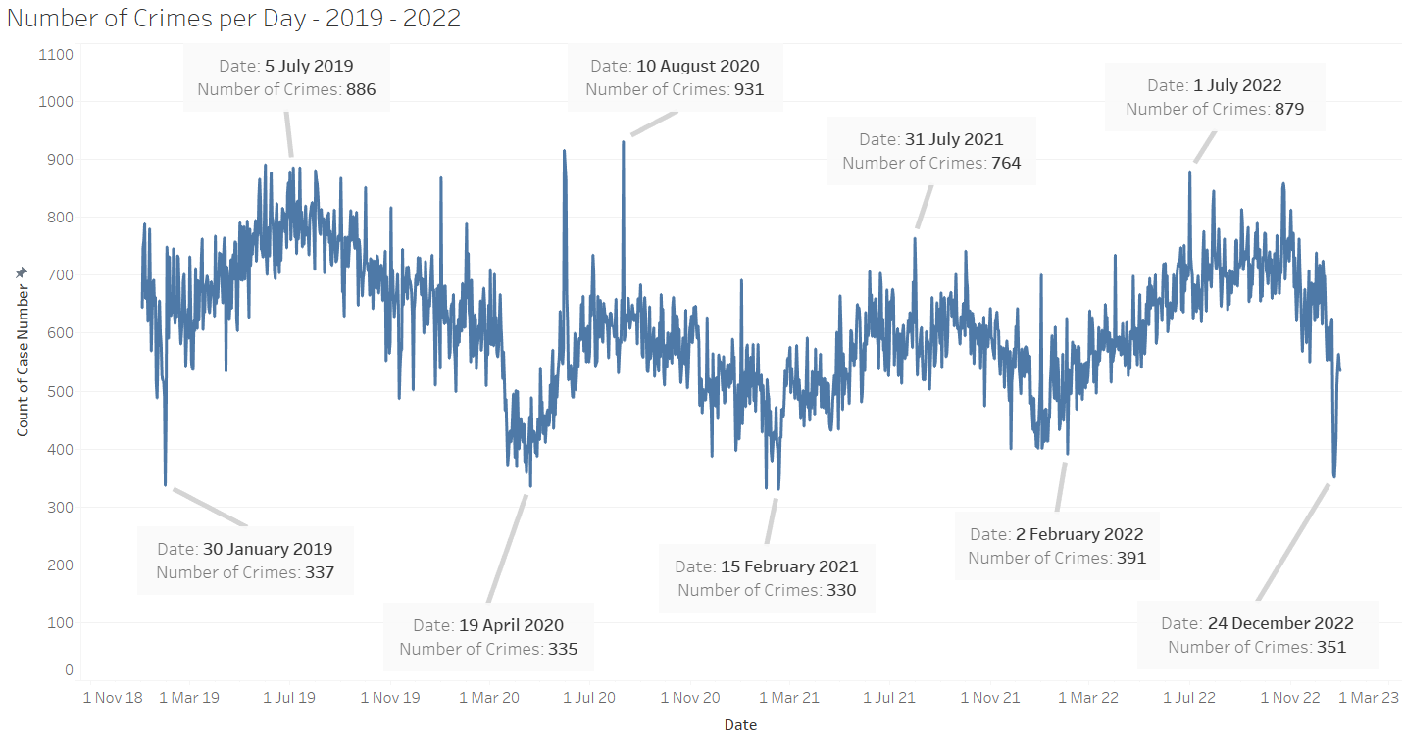
EDA: 2019-2022 cRIME REPORTS trend
Notes:
We can see a seasonal trend in the number of crimes (higher during warmer months)

Slide 9
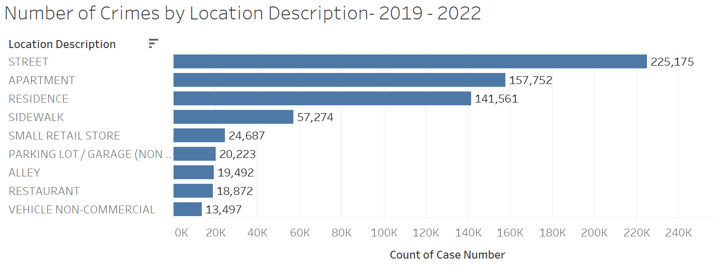
EDA: 2019-2022 cRIME by location type
Notes:
Theft, battery, burglary were common crimes

Slide 10
03
ANALYSIS OBJECTIVES

Slide 11
OBJECTIVE: ENHANCE THE CITY OF CHICAGO CRIMES DASHBOARD
Show ‘time of day’
Analyzing the time of day when crimes are committed could help police determine when to allocate resources and where to focus their attention
More focus on filtering by ‘types of crime’
Breaking down the types of crimes reported (e.g. burglary, robbery, assault, etc.) would help police identify patterns and target their resources more effectively
Simplify filters and interactivity of the dashboard so that any interested party can use it with ease

Slide 12
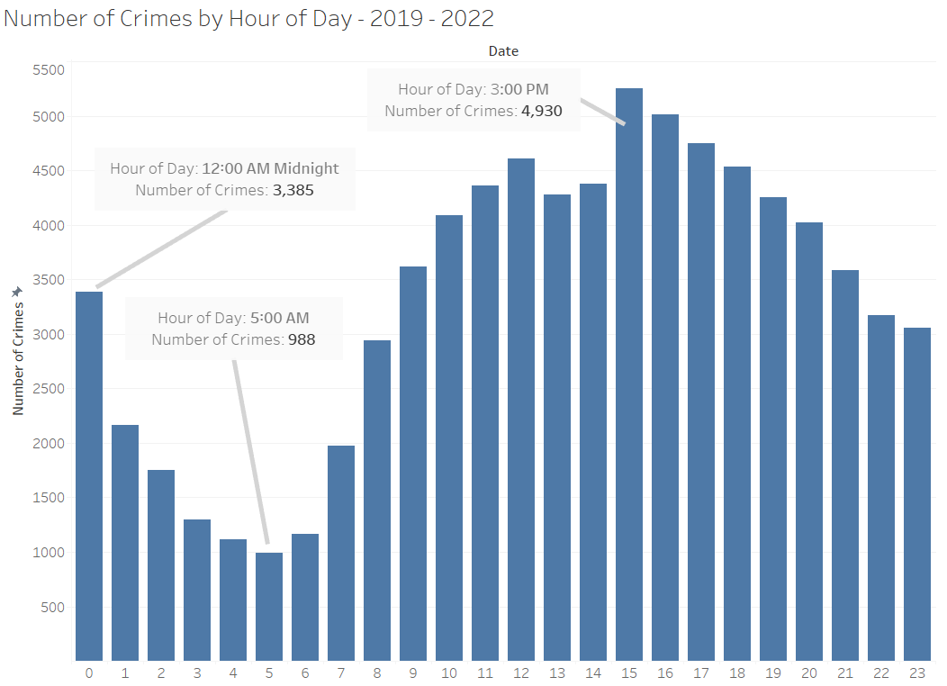
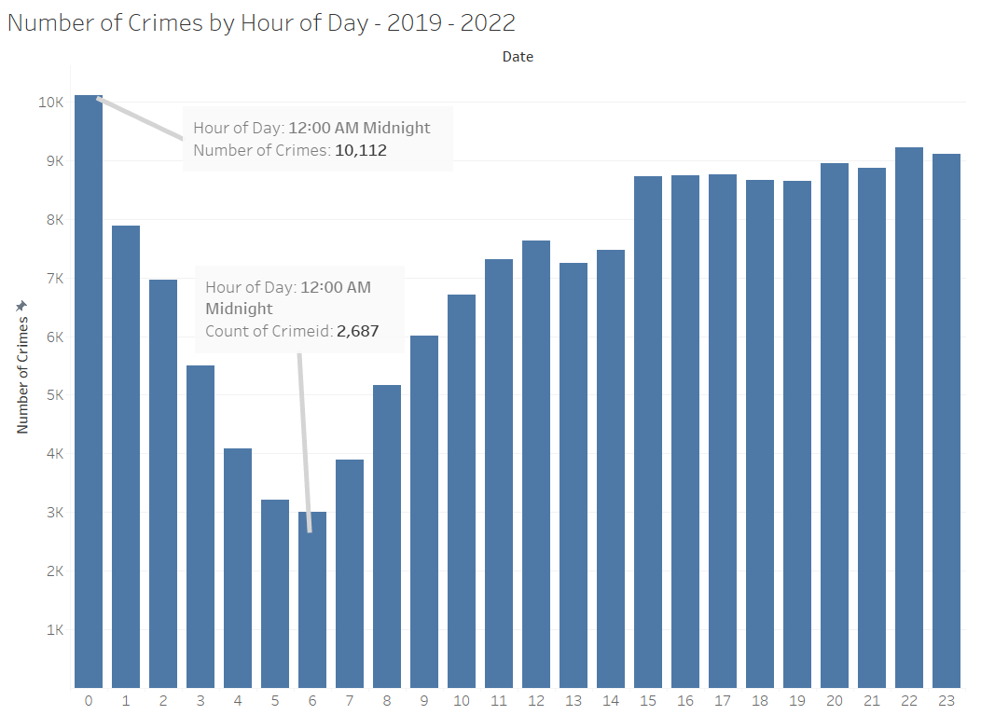
FOR EXAMPLE: different crimes peakED at different times DURING the day
ASSAULT
BATTERY

Slide 13
04
METHODOLOGY

Slide 14
Methodology
Data cleaning
Creating maps
creating graphs
Dashboard
assembly
Python
Python
Tableau
HTML/CSS

Slide 15
05
REPORTS & DASHBOARD

Slide 16
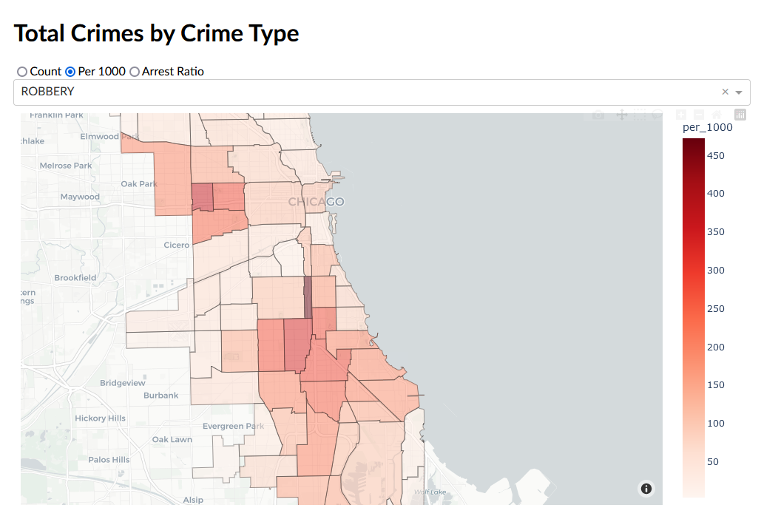
Dashboard Content: Total Crimes by Crime Type
Our interactive dashboard is embedded on the following webpage:
http://www.danleedata.com/crimedashboard
This is an interactive map showing different community areas
Hover over the area to see the neighborhood name
Filter by:
total number of reports
reports per 1000
arrest ratio

Slide 17
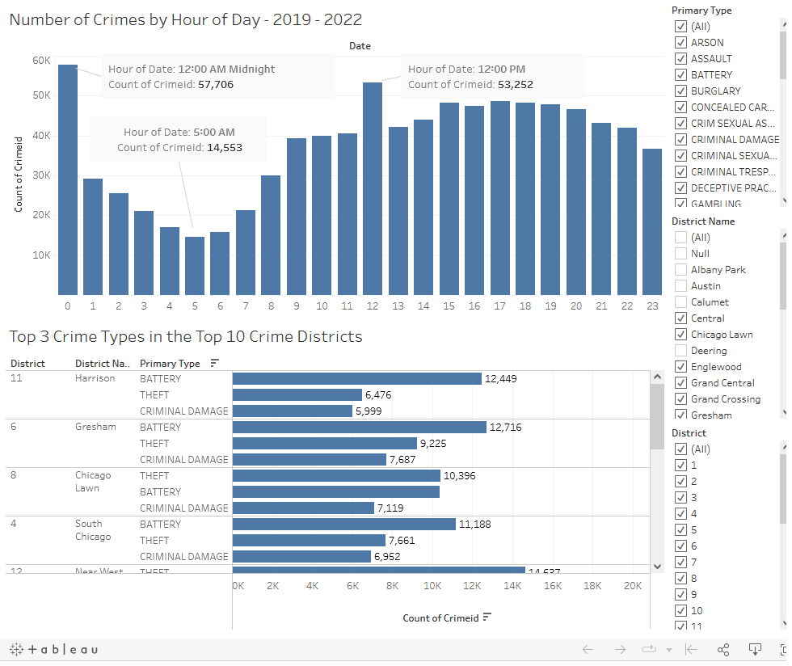
Dashboard Contents: Number of Crimes by Hour of Day
& Top 3 Crime Types in the Top 10 Crime Districts
Number of Crimes by Hour of Day (2019 - 2022 data)
This interactive plot can be filtered by crime type
The first bar represents all the incidents which occurred an hour after midnight, the second bar between 1-2 AM and so on
Top 3 Crime Types in the Top 10 Crime Districts (2019 - 2022 data)
This interactive plot can be filtered by district name/number

Slide 18
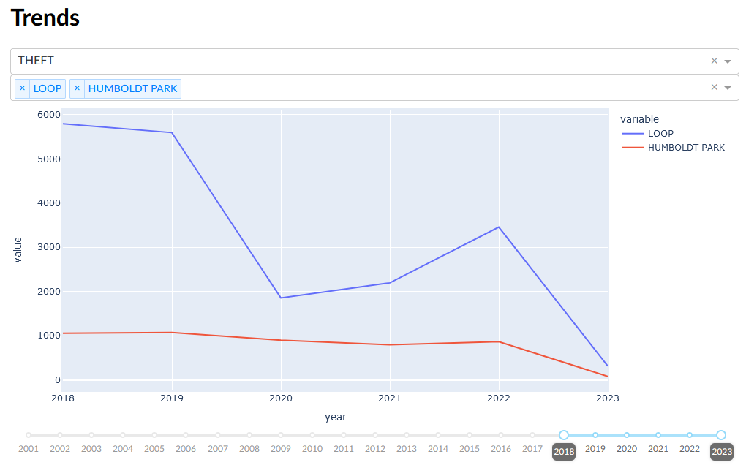
Dashboard Content: Crime Trends
This interactive visualization shows Crime Trends over time (since 2001)
We can filter by:
crime type
neighborhood
different time periods (slider)
We can compare trends between different neighborhoods
For example, we can see that the Loop had higher number of incidents overall than Humboldt Park

Slide 19
06
INSIGHTS & RECOMMENDATIONS

Slide 20
Exploratory data analysis Insights
Chicago witnesses highest counts of Crime in Summer and Autumn months, with 10th Aug 2020 having the highest number of crimes (931) and 15th Feb 2021 having the lowest (330)
Most Crimes in Chicago occur between 5pm - 1am with a peak at around 12 am and witnesses least crimes at 5 am and early morning times
Most crimes take place on the streets of Chicago followed by indoor places of residence like Apartments
Theft, Battery, Criminal Damage and Assault account for the majority of crimes that take place in Chicago
The most common types of Crime are reported across all parts of Chicago, with Central, Southern and Western districts being particular Hotspots
Harrison, Gresham, Chicago Lawn, and Near West districts witness the highest number of crimes with Physical Assault and Theft on Streets and in Apartments being the most common

Slide 21
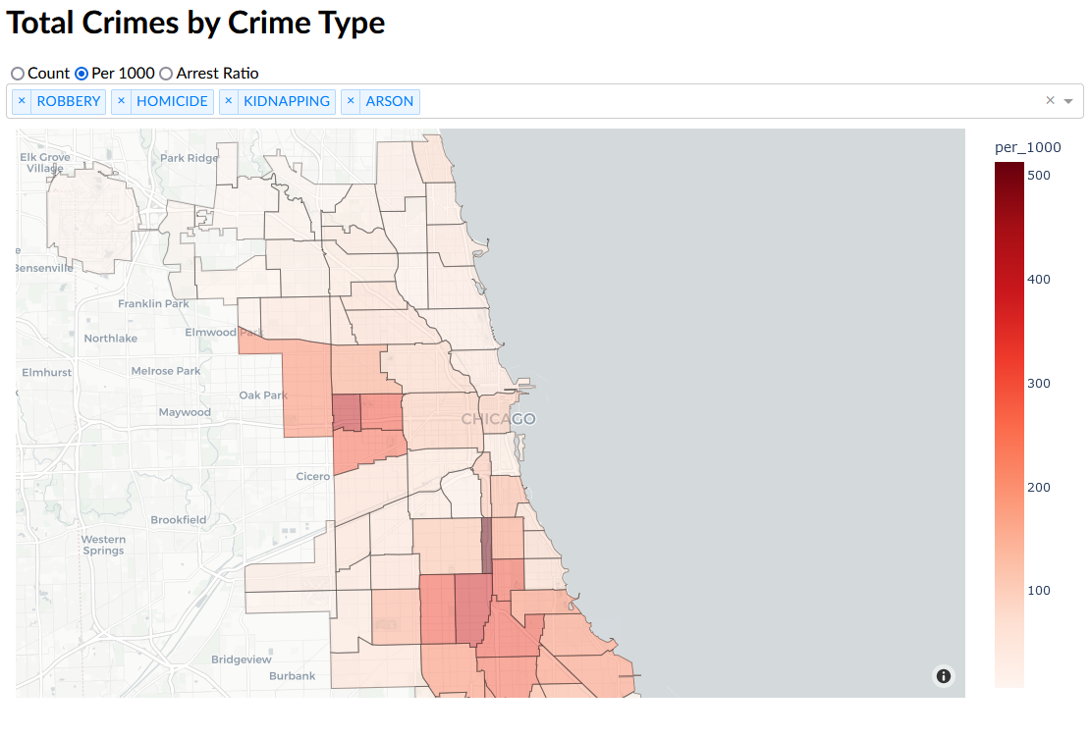
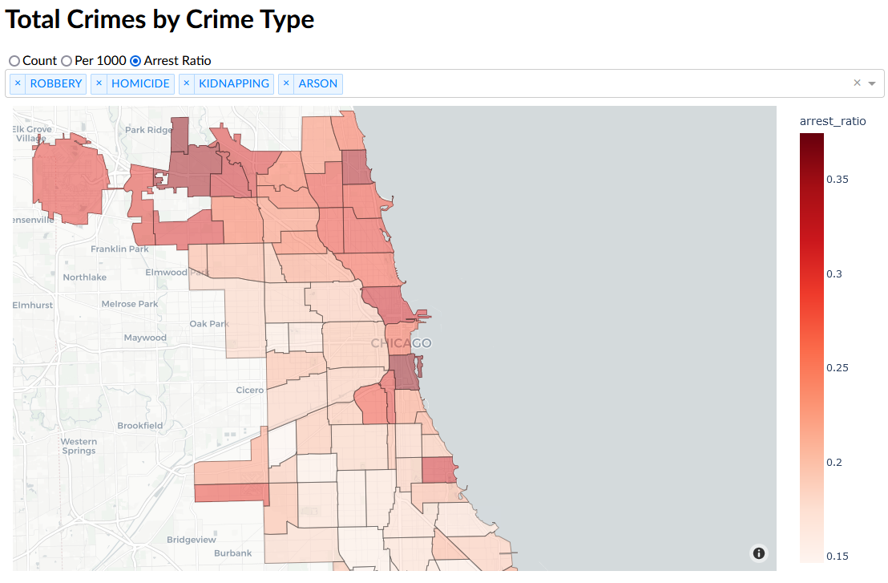
Hot Spot neighborhoods: filtered by robbery, homicide, kidnapping & arson
High Violent Crimes - Reports per 1000
High Violent Crimes - Arrest Rate
High violent crime rates are not correlated with their arrest rates in Chicago neighborhoods
This indicates that there are not enough resources being deployed to these areas
We also see a trend of neighborhood crime “leaking” to adjacent neighborhoods due to similar socioeconomic factors as well as proximity
Notes:
High violent crime neighborhoods: Fuller Park, Englewood, West Englewood, Washington Park, West Garfield Park, etc.
High violent crime most arrests: (are not the neighborhoods above)
Norwood Park, Near South Side, Edgewater, Loop
This insight is a
Signal for the city to reallocate resources
Warning for businesses who are looking to expand into these neighborhoods

Slide 22
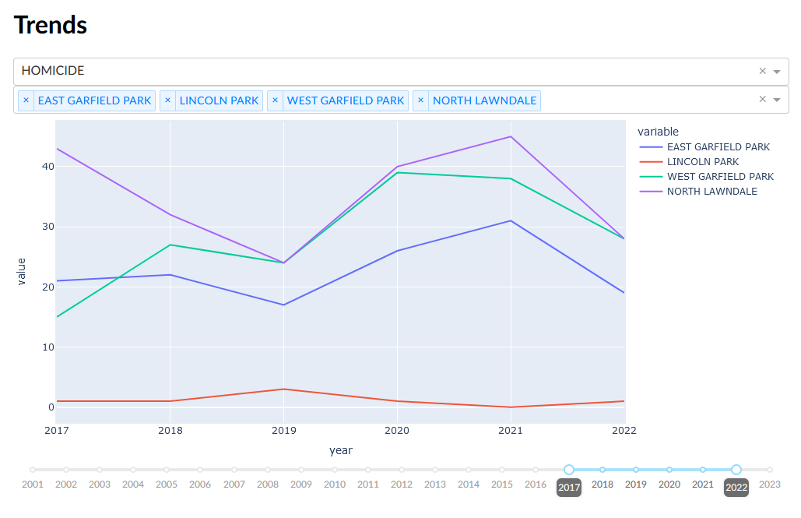
HOMICIDE RATES over time:
In 3 high-crime NEIGHBORHOODS vs. Lincoln park
In North Lawndale, East and West Garfield Park, homicide rates dropped until 2019, increased between 2019-2021, after which they began to decline again
However, the homicide rate in these neighborhoods are still relatively high, especially compared to neighborhoods such as Lincoln Park
Suggestion for local businesses: wait to see if the downward trend in crime rate continues for longer before considering expanding into these “hot-spot” neighborhoods

Slide 23
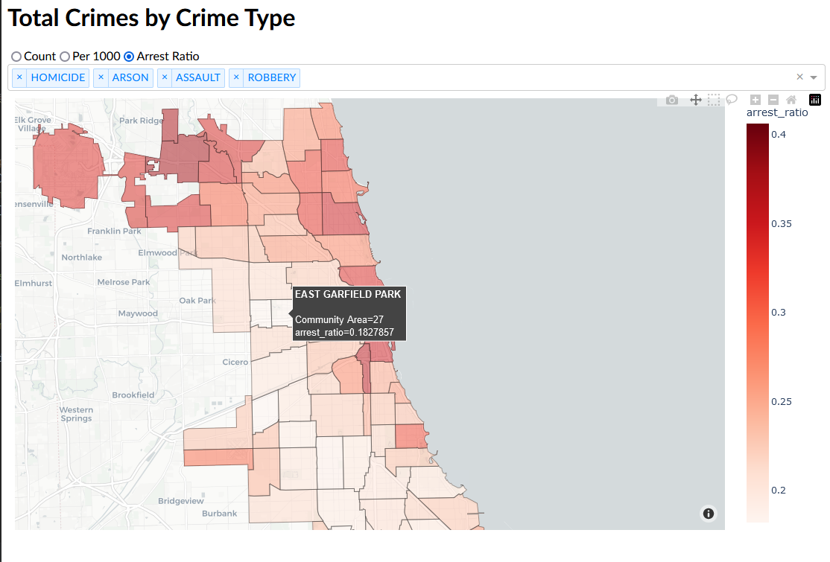
High-crime & low-arrest neighborhoods: recommendations
Short-term recommendations:
Divert and/or increase investigative resources to neighborhoods with high violent crime and lower arrest ratios
Ask the public to pay more attention to safety in Summer and Autumn
Long-term recommendations:
Increase investments in street outreach programs to improve effectiveness
Increase investments in youth programs in neighborhoods and surrounding areas
More patrolling at night (5pm - 1am) especially in the South and the Central districts of Chicago
Notes:
https://www.chicago.gov/city/en/sites/public-safety-and-violence-reduction/home/VR-overview.html
Therefore, our recommendation is two fold. A short term strategy is to divert and/or increase resources to neighborhoods with more violent crime to establish a police presence and reduce these violent crimes
A longer term strategy is to get to the root of the problem, which is increase investments in street outreach programs and youth programs in neighborhoods and surrounding areas.

Slide 24
appendix

Slide 25
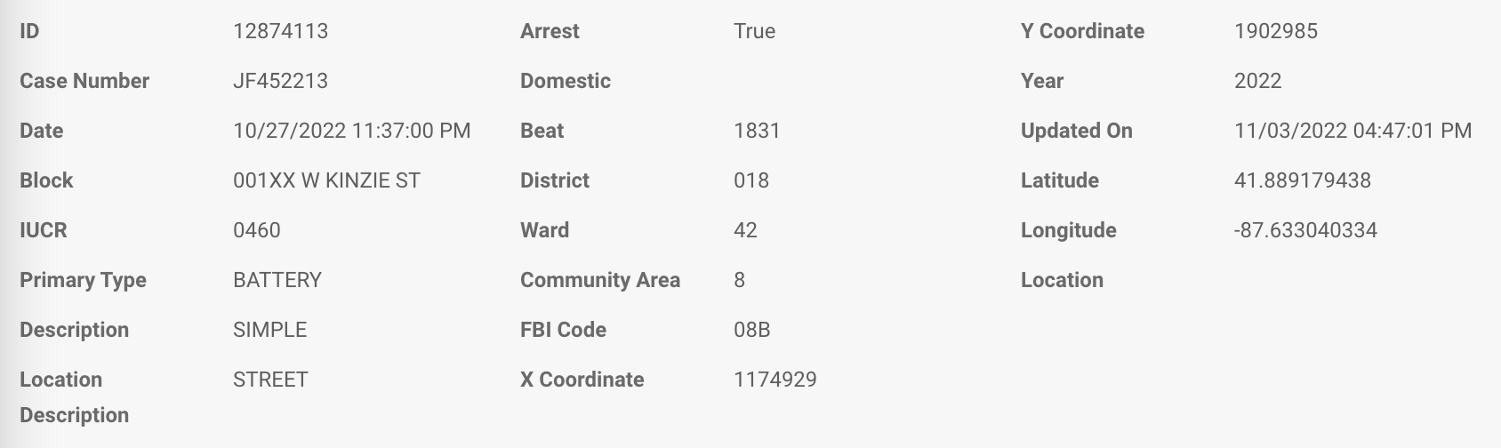
Data source
https://data.cityofchicago.org/Public-Safety/Crimes-2001-to-Present/ijzp-q8t2
Here are the 22 columns reported in the data:
Notes:
Pathik

